Slide 1

WG2 Self-Check
10 ticks before a PCR may say “WE ALIGN”
Interim verification instrument for the alignment statement (IDDI Guidance for PCR Harmonization v1.0, rule 1.1)
IDDI Working Group 2 - chair working material - August 2026 - draft v0, not an IDDI position
1 / 13

Slide 2
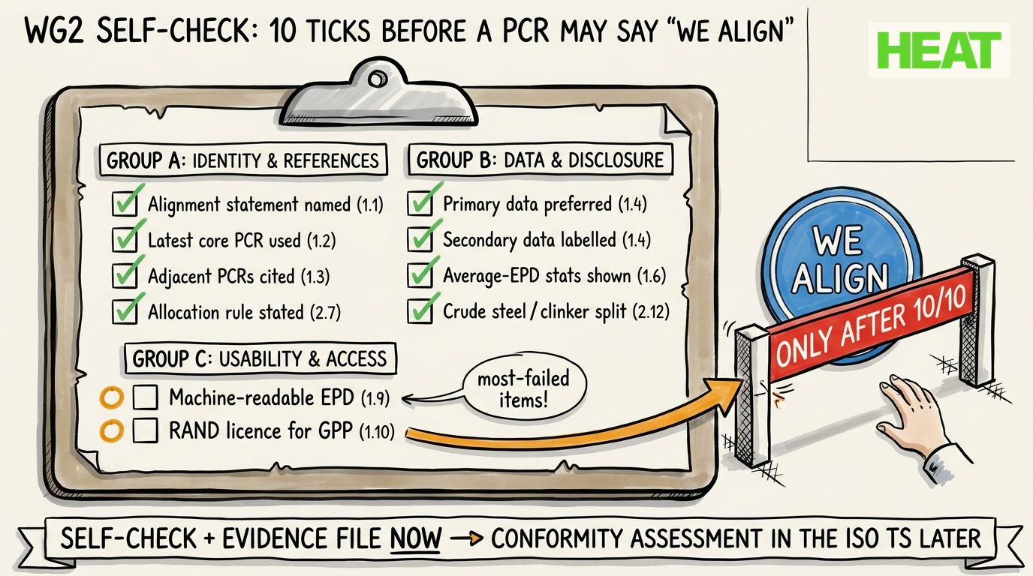
The checklist at a glance
2 / 13

Slide 3
Check 1 - Alignment statement named
Rule 1.1 | Group A - Identity & references
WHAT IT REQUIRES
PCR follows the standard naming convention and carries an explicit statement declaring alignment with Guidance v1.0, naming the Guidance version.
EVIDENCE EXPECTED (one line in the evidence file)
Statement text + PCR title page.
WHY IT MATTERS
Makes the alignment claim visible, citable and checkable in procurement documents.
TYPICAL FAILURE
Vague wording ('informed by IDDI') with no version named — unverifiable claim.
3 / 13

Slide 4
Check 2 - Latest core PCR used
Rule 1.2 / 2.1 | Group A - Identity & references
WHAT IT REQUIRES
Review starts from the most recent core PCR (ISO 21930:2017 or EN 15804+A2) plus compliant sub-PCRs; modules and product sub-categories derived per the reference standard.
EVIDENCE EXPECTED (one line in the evidence file)
Reference-standard clause in the PCR.
WHY IT MATTERS
Prevents harmonizing against outdated baselines that re-open settled gaps.
TYPICAL FAILURE
Building on superseded EN 15804+A1 or an expired sub-PCR.
4 / 13

Slide 5
Check 3 - Adjacent PCRs cited
Rule 1.3 | Group A - Identity & references
WHAT IT REQUIRES
Consistency of the emissions-accounting approach across construction PCRs and the steel / cement / concrete sub-PCRs is stated, with adjacent PCRs cited.
EVIDENCE EXPECTED (one line in the evidence file)
Citation list of adjacent PCRs.
WHY IT MATTERS
Comparability between functionally similar products; no bias between substitutable materials.
TYPICAL FAILURE
Silent divergence from the adjacent steel or cement rules.
5 / 13

Slide 6
Check 4 - Allocation rule stated
Rule 2.7 | Group A - Identity & references
WHAT IT REQUIRES
Allocation approach for co-outputs is stated and aligned between the systems that produce and use them; other PCRs considered are cited; co-output emissions fully accounted.
EVIDENCE EXPECTED (one line in the evidence file)
Allocation clause + cross-reference to adjacent PCRs.
WHY IT MATTERS
Stops emissions being deleted at system level when steel and cement use different methods.
TYPICAL FAILURE
Steel PCR credits slag under one method while the cement PCR inherits it under another.
6 / 13

Slide 7
Check 5 - Primary data preferred
Rule 1.4 | Group B - Data & disclosure
WHAT IT REQUIRES
Clear preference and expectation for primary data on own processes and high-impact upstream steps (energy, purchased iron, purchased cement/clinker).
EVIDENCE EXPECTED (one line in the evidence file)
Data-requirements clause.
WHY IT MATTERS
Upstream drives the result: iron up to ~50% of steel emissions, cement up to ~85% of concrete.
TYPICAL FAILURE
Generic data accepted where the actual supplier is more emissive than the average.
7 / 13

Slide 8
Check 6 - Secondary data labelled
Rule 1.4 | Group B - Data & disclosure
WHAT IT REQUIRES
Wherever secondary data is used, the database or source is named in the EPD.
EVIDENCE EXPECTED (one line in the evidence file)
Labelling requirement in the PCR.
WHY IT MATTERS
Buyers can distinguish measured from assumed values; background databases differ by ~10-11% for the same product.
TYPICAL FAILURE
Unlabelled mix of ecoinvent / GaBi values inside one declaration.
8 / 13

Slide 9
Check 7 - Average-EPD statistics shown
Rule 1.6 | Group B - Data & disclosure
WHAT IT REQUIRES
Industry-average / multi-site / multi-product EPDs must publish sample size, min and max GWP, standard deviation and represented production volume.
EVIDENCE EXPECTED (one line in the evidence file)
EPD content requirement.
WHY IT MATTERS
Tender usability: an 'average' of 3 plants is not an average of 300 — spread decides comparability.
TYPICAL FAILURE
A single average number with no spread information.
9 / 13

Slide 10
Check 8 - Crude-steel / clinker split disclosed
Rule 2.12 | Group B - Data & disclosure
WHAT IT REQUIRES
Separate disclosure of GWP per 1 t crude steel + scrap share (steel), clinker-to-cement ratio (cement), and cement GWP inside the concrete EPD.
EVIDENCE EXPECTED (one line in the evidence file)
Disclosure clause.
WHY IT MATTERS
Enables comparison at the common production step and evaluation against low / near-zero thresholds.
TYPICAL FAILURE
Only the finished-product GWP is reported — no common-step value.
10 / 13

Slide 11
Check 9 - Machine-readable EPD
Rule 1.9 / 2.14 | Group C - Usability & access
WHAT IT REQUIRES
EPDs are published in a machine-readable digital format compliant with an open data standard (e.g. openEPD, ILCD+EPD), named in the PCR.
EVIDENCE EXPECTED (one line in the evidence file)
Format requirement naming the standard.
WHY IT MATTERS
The 2030 GPP disclosure expectation is machine-readable open data; procurement tools and databases depend on it.
TYPICAL FAILURE
PDF-only EPDs. Empirically one of the two most-failed items.
11 / 13

Slide 12
Check 10 - RAND licence for procurement
Rule 1.10 | Group C - Usability & access
WHAT IT REQUIRES
PCRs specified for public procurement are available to users on Reasonable and Non-Discriminatory licensing terms.
EVIDENCE EXPECTED (one line in the evidence file)
Licence statement.
WHY IT MATTERS
Procurement equity — paywalled rules exclude bidders, hitting low-EPD markets hardest.
TYPICAL FAILURE
Paywalled standard documents as the only access route. The second most-failed item.
12 / 13

Slide 13
Rules of use & sunset
10/10 with evidence = alignment statement
Only a fully ticked list with a one-page evidence file earns the statement. Anything less must say 'partially aligned' and name the open items.
Program operator attests (rule 1.8)
The evidence file is published alongside the PCR; the program operator attests under its data-quality responsibility. No new institutions needed.
Feeds the landscape study
The ten items double as coding indicators - track items 9 and 10 (machine-readability, RAND access) explicitly; they are the most-failed.
Sunset clause
This checklist retires the day the ISO TS conformity-assessment mechanism enters into force. It is scaffolding, not the building.
13 / 13

